Slide 1

3 Click System
Audrey Clanton, Noah Skaar, Kevin Cross, and Blake Bellinger

Slide 2

Project Objective: Make registering for classes simpler.

Slide 3
The problem
Currently, students are forced to look up their own plan of study and manually find what they have already taken.
Issues with this system include:
confusion with which classes to take,
changing plan of studies,
switching of majors,
unnecessary amount of pages to navigate through
Happy Students |  | Unhappy Students

Slide 4

The solution
We want students to be able to bring up a list of classes required to take for their major
Each class will be listed as either green (for classes previously taken) or red (for classes needed to graduate)
Additionally, students will be able click on the needed courses and bring up a list of classes available and simply register.

Slide 5
How it works
Click 3
Click 2
Click 1
Register
Select the day/time
Select the class
3
2
1

Slide 6
Schedule
SDLC
August 2019
October 2019
December 2019
September 2019
November 2019
Project Systems planning and selection
Project systems design
Finished Product and Pitch
Jan | Feb | Mar | Apr | May | Jun | Jul | Aug | Sept | Oct | Nov | Dec
Project Systems analysis
Implementation and Operation

Slide 7
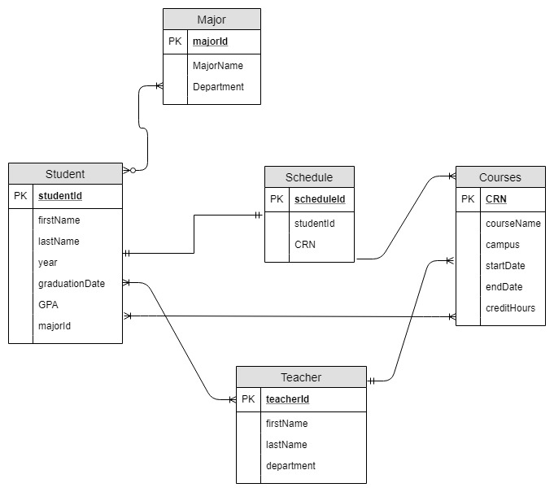
ERD

Slide 8
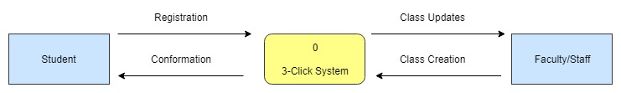
Context Diagram

Slide 9
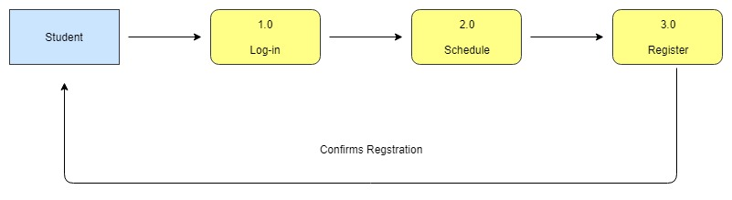
Data Flow Diagram - Level 1

Slide 10
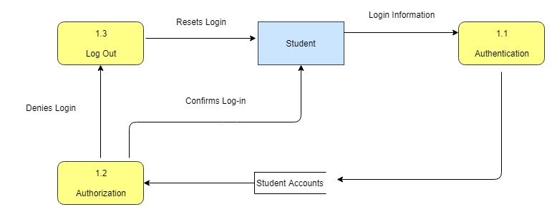
Data Flow Diagram - Login

Slide 11
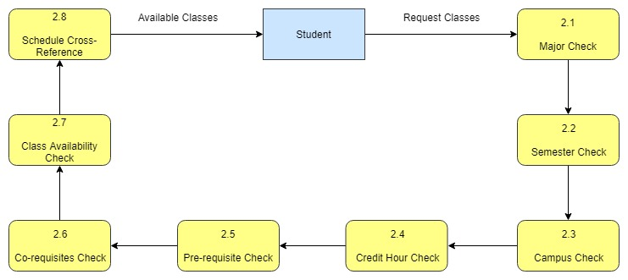
Data Flow Diagram - Schedule

Slide 12
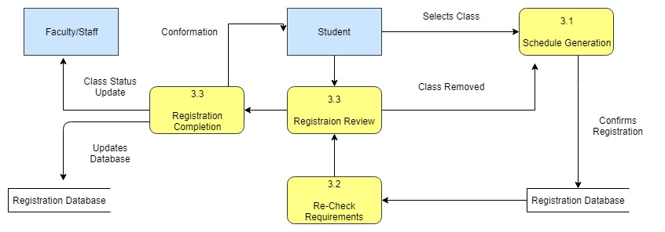
Data Flow Diagram - Register

Slide 13

User Interface
The 3-click system

Slide 14
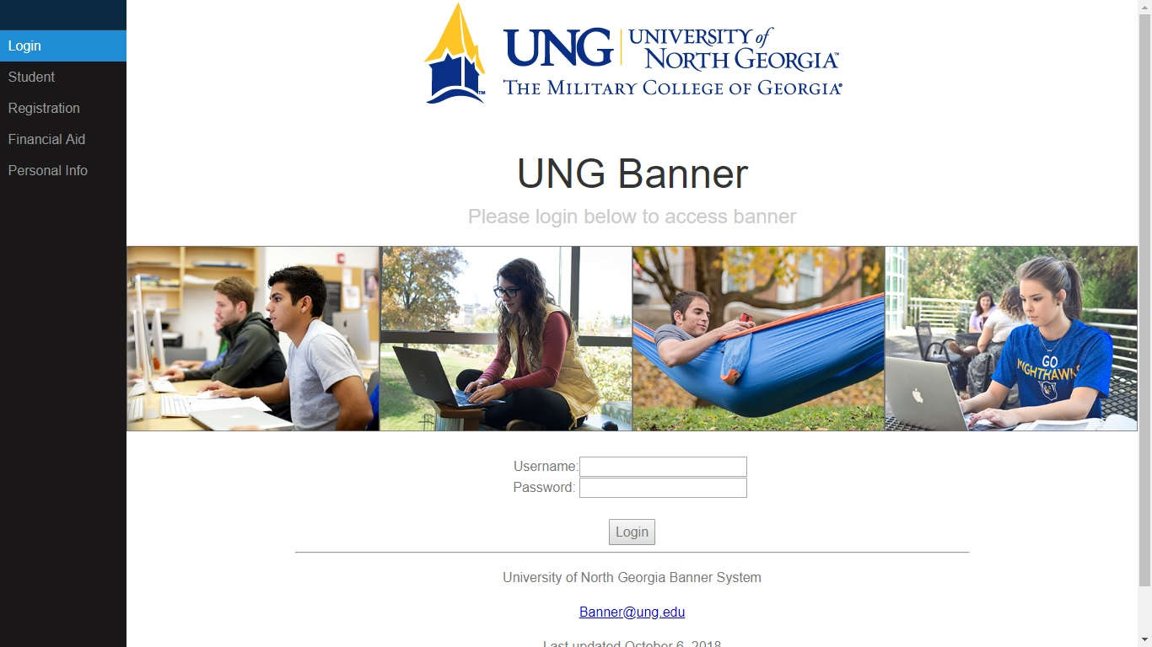

Slide 15
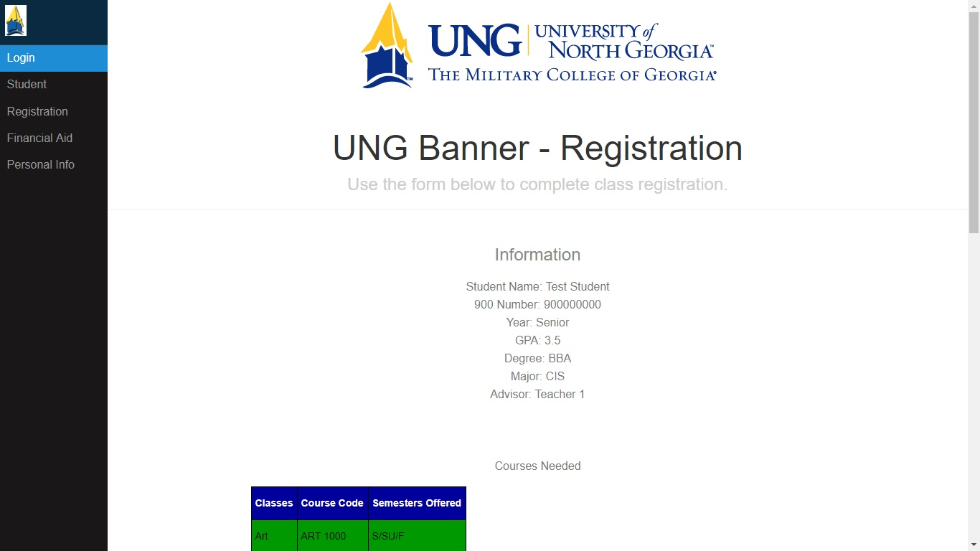

Slide 16
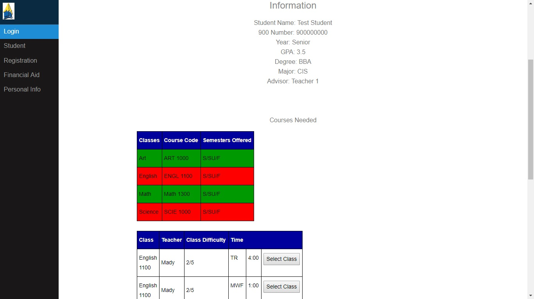
Click 1

Slide 17
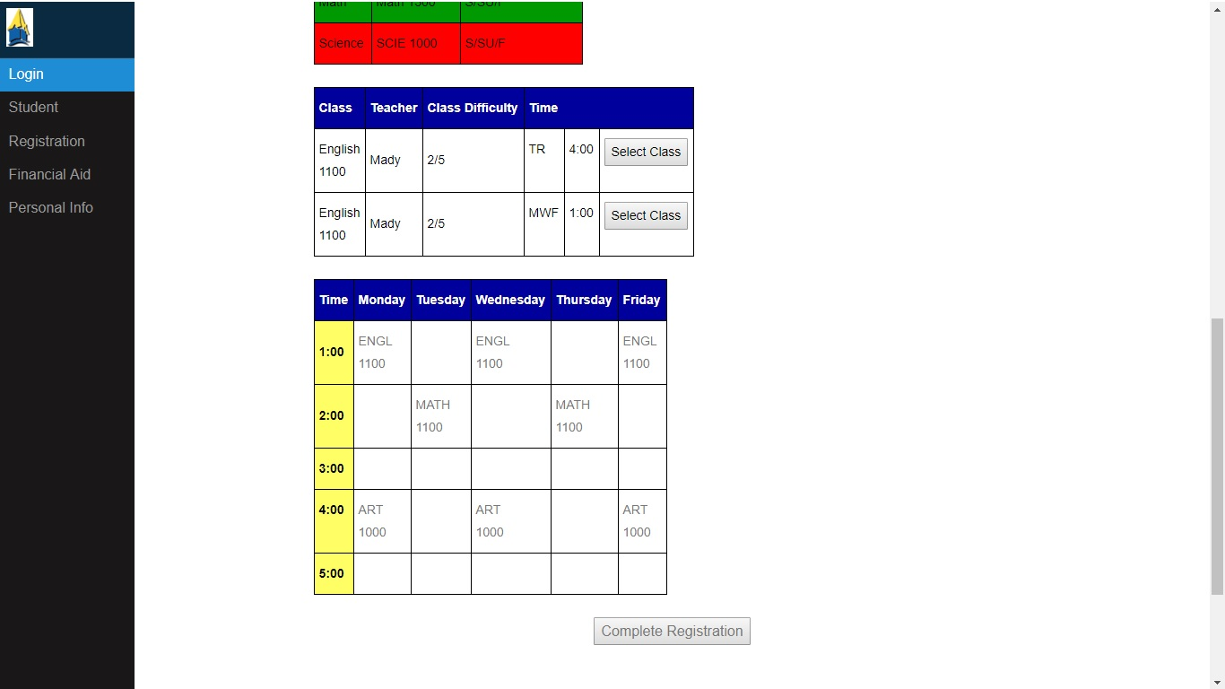
Click 2
Click 3

Slide 18
Any Questions?

